Slide 1

Avocado Price Prediction using Machine Learning
Authors:
Sathish K
Sudharsanan G
Sai Srinivasan M
Thrisheiyan U K
Utkrisht Arya

Slide 2
Introduction
Objective:
The goal is to create an accurate predictive model for avocado prices, helping stakeholders anticipate price fluctuations.
Importance:
Reliable price forecasting aids in understanding market trends, enabling avocado producers and retailers to make informed business decisions and optimize inventory and pricing strategies.

Slide 3
Data Overview
Description:
Dataset is taken from Kaggle website which data has around 18k observations of 14 columns .
Various variables present in dataset such as Date, AveragePrice , Total volume , Total Bags , Year , Type .
Features: Date ,Total Volume, Total Bags , Small Bags ,Large Bags, XLarge Bags , type , year , region.

Slide 4
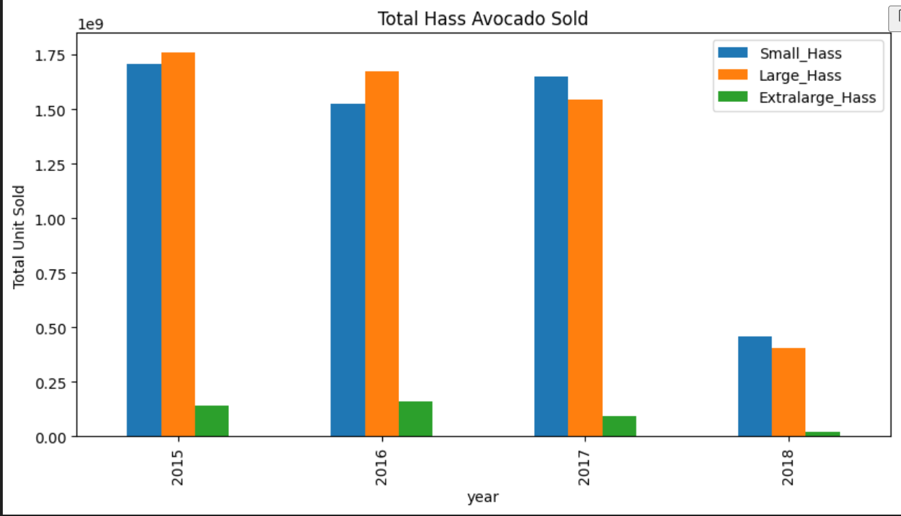
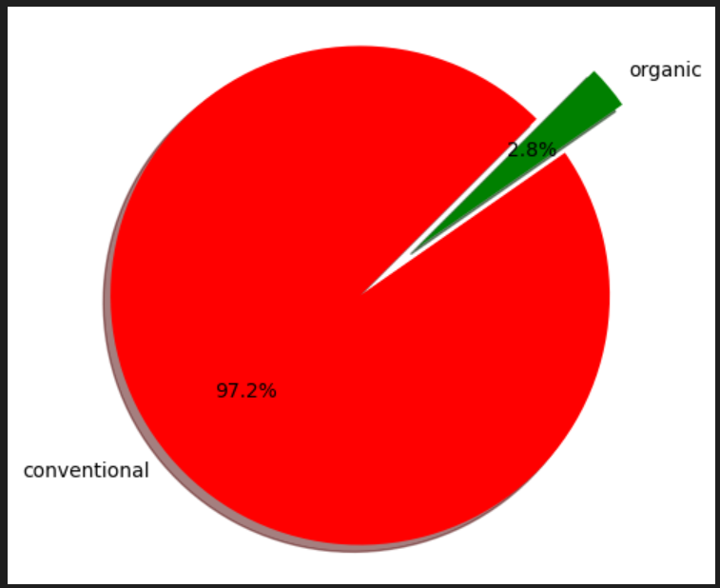
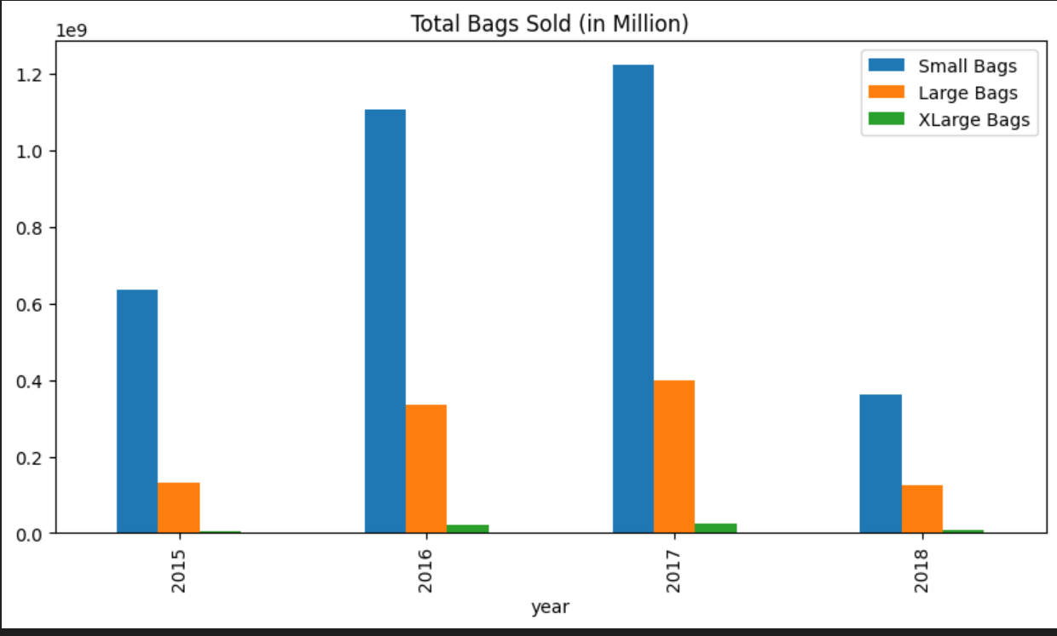
Visualization

Slide 5
Model Selection
Models:
Linear Regression - establish a baseline for understanding the relationship between features
Decision Tree Regression – flexible, non-linear models that can capture complex relationships between features and price
Random Forest Regressor - multiple trees to reduce overfitting and improve accuracy.

Slide 6
Model Training
Linear Regression:
Accuracy Score : 0.6217330509756727
Decision Tree Regression:
Accuracy Score : 0.7421516896228717
Random Forest Regressor:
Accuracy Score : 0.879855700263251

Slide 7
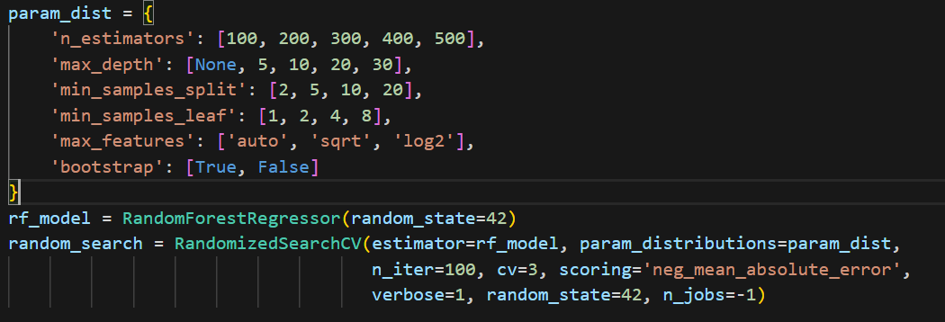
Hyperparameter Tuning
Hyperparameter Tuning : RandomizedSearchCV

Slide 8
Best Model
Model: Random Forest Regressor
Performance Metrics:
R² Score: 0.89
Mean Absolute Error: 0.10

Slide 9
Web Application
Frontend: HTML , CSS , Bootstrap
Backend : Python
Deployment : local host : 127.0.0.1:5000

Slide 10
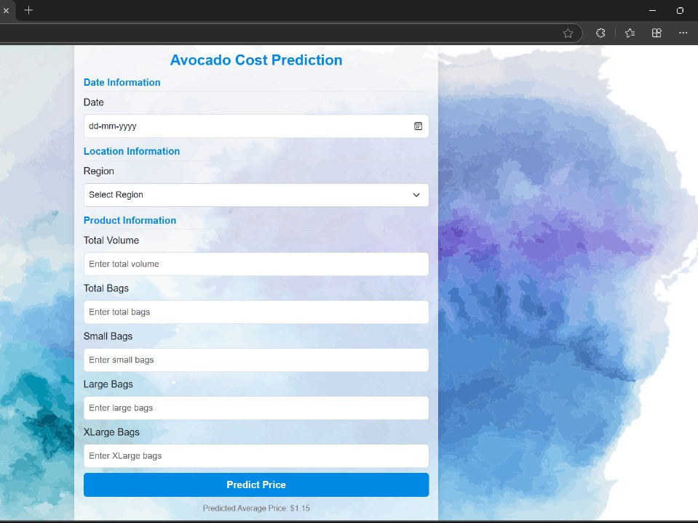
Demo
Screenshots :

